Slide 1
Camera battle transitions
Alejandro Martín Ortega

Slide 2
Index
What are camera battle transitions
Common transitions used in videogames
Selected aproach
TODO

Slide 3
What are camera battle transitions?
A way to tell the player an encounter has started
Important for the UX aspect of the game

Slide 4
Common transitions used in videogames:

Slide 6
Selected aproach for the problem
-Usage of easings to do the functions
-Easy implementation
-Can it be improved?

Slide 7
TODO 1:
Using the Enum "currentStep" create a switch that inside of the case TRANSITION will increase the variable "time_in_transition"
and depending on the animation selected it will call to the respective funciton. Do the same for the case FROM_TRANSITION but instead of increasing it's time
decrease the variable "time_out_transition"

Slide 8
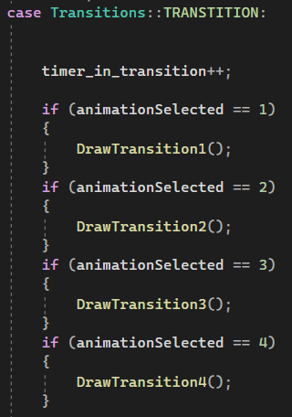
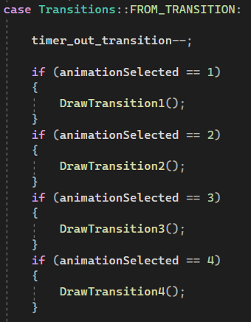
TODO 1 SOLUTION:

Slide 9
TODO 2:
Create an if statement to change from TRANSITION to FROM_TRANSITION and viceversa once the conditions are met
- time_in_transition is bigger or equal than time_out_transition
- time_out_transition is smaller or equal than 0

Slide 10
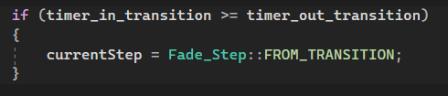
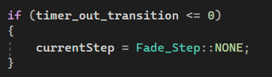
TODO 2 SOLUTION:

Slide 11
TODO 3:
Complete this function so the integers given by the player are passed to the values of the class, take into account the steps of the transition

Slide 12
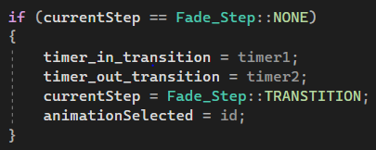
TODO 3 SOLUTION:

Slide 13
TODO 4:
Create a wiping transition using a Rect that will fill the whole screen and will move horizontally remember that it has to come back to it's starting point in a smooth way

Slide 14
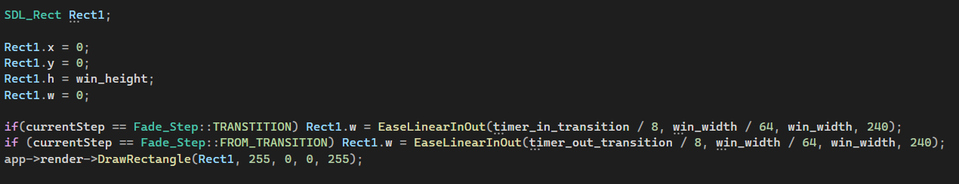
TODO 4 SOLUTION:

Slide 15
TODO 5:
Create 4 rects that will interpolate directions and will act the same as the wiping transition from before

Slide 16
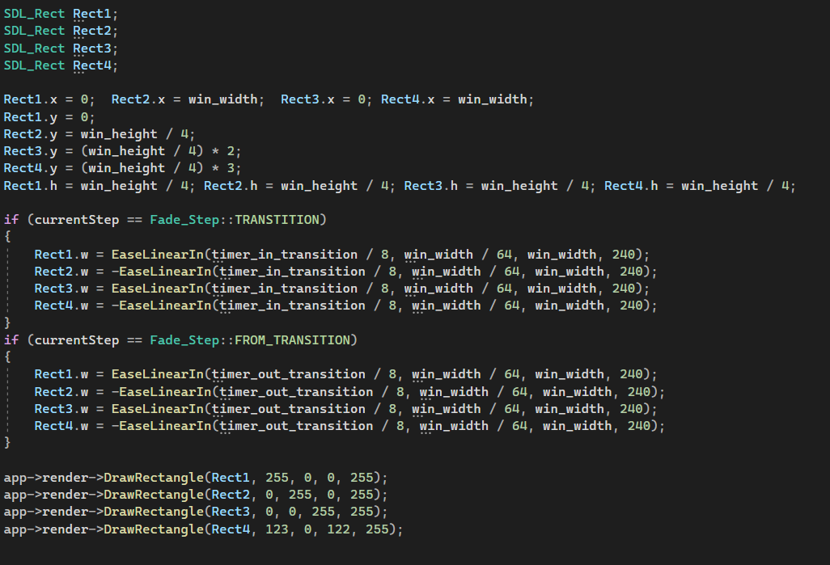
TODO 5 SOLUTION:

Slide 17
TODO 6:
Create a similar function to the TODO 5, but in this case you will create 5 interpolating rects that will have also a texture drawn on top and will update it's position alongside with the rect

Slide 18
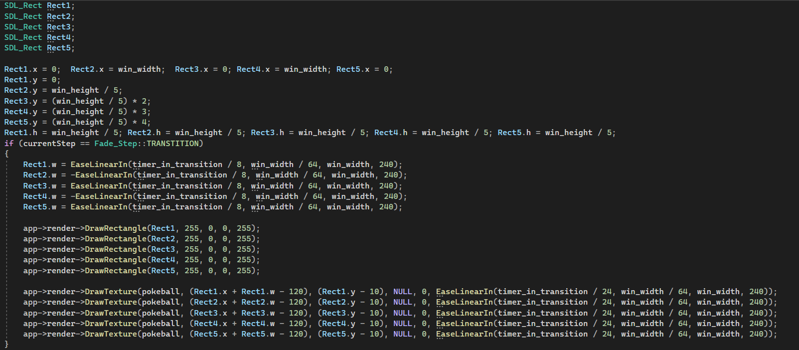
TODO 6 SOLUTION:

Slide 19
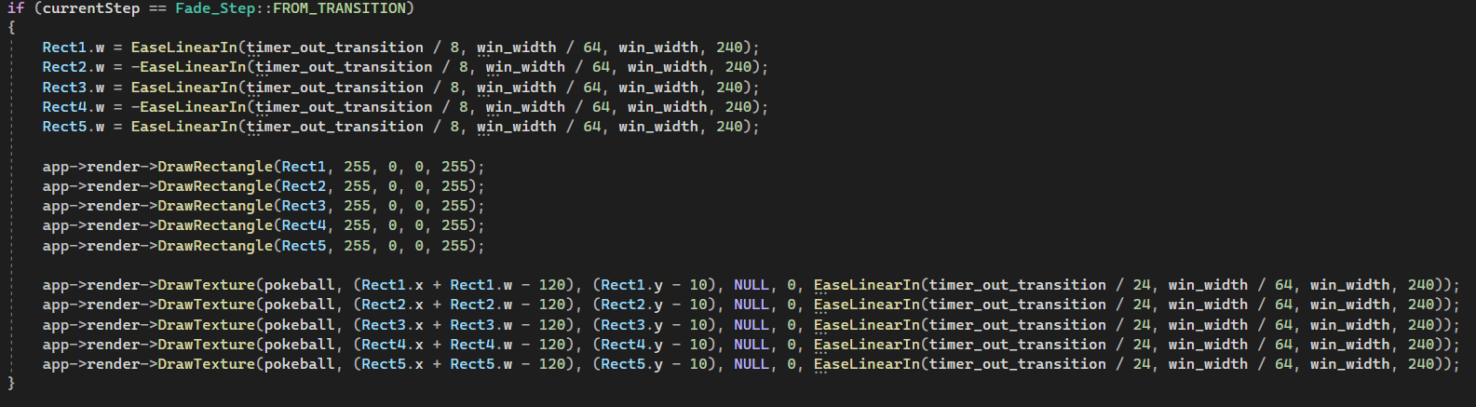
TODO 6 SOLUTION PART 2

Slide 20
TODO 7:
Create a rect that will Fade in and out

Slide 21
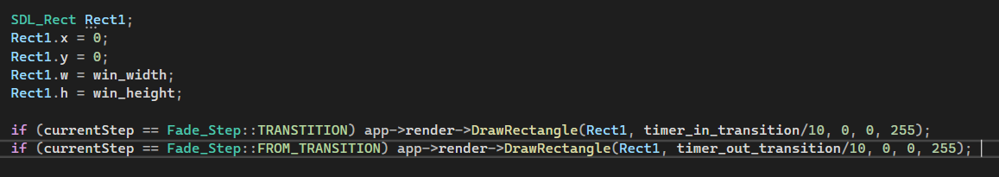
TODO 7 SOLUTION:

